Slide 1



OOP - Fundamentals II
Abstraction, Polymorphism
SoftUni Team
Technical Trainers
Software University
http://softuni.bg

Slide 2
Questions
sli.do #PHP-WEB

Slide 3
CheckList
Classes & Objects
Inheritance
access levels
parent constructors
overiding methods
Encapsulation
Visibility
Getters & Setters
Magic methods

Slide 4
Inheritance: Important Aspects
There is no multiple inheritance
Constructors are inherited if child not exists constructor exists
Extended class could add new members, but couldn’t remove derived members
New members with the same name hide the inherited ones
Private members are accessible through the parent setters and getters
Public and Protected members are overwritten

Slide 5
Try to Build This Hierarchy
Game
SinglePlayerGame
MultiplePlayersGame
Minesweeper
Solitaire
BoardGame
Chess
Backgammon

Slide 6


Table of Contents
Fundamental Principles of OOP
Abstraction
Hide complexity
Polymorphism
Abstract Classes
Interfaces

Slide 7
Fundamental Principles of OOP
Abstraction
Hide complexity
Encapsulation
Hide internal data
Inheritance
Inherit members from parent class
Polymorphism
Different functionality while sharing a common interface

Slide 8
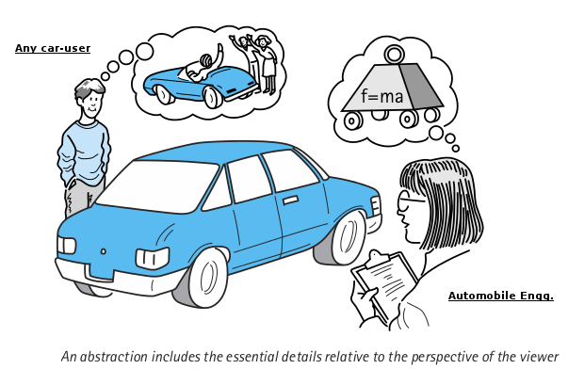
Abstraction

Slide 9
Abstraction
Hides all but the relevant data about an object in order to reduce complexity and increase efficiency.
Abstraction is a concept that takes place anywhere in a software system where 'making things more general/simpler/abstract' is involved.
An inheritance hierarchy, where the higher classes are simpler or more general, and define more general and abstract implementation. While the lower classes in the hierarchy are more concrete and define more detailed implementations.
Using encapsulation to hide the details of implementation of a class from other classes, thus making the class more 'abstract' (simpler) to the outside software world.
Notes:
Encapsulation hides the implementation details
Class announces only a few operations (methods) available for its clients – its public interface
All data members (fields) of a class should be hidden
Accessed via properties (read-only and read-write)
No interface members should be hidden
Encapsulation == hide (encapsulate) data behind constructors and properties

Slide 10
Abstraction - Example
Let's take DateTime class as an example
We know how to use the methods without worrying how they do their job
DateTime implements DateTimeInterface {
public DateTime add(DateInterval $interval)
public DateTime setTimestamp(int $unixtimestamp)
public DateTime setTimezone(DateTimeZone $timezone)
public DateInterval diff(DateTimeInterface $datetime2 [, bool $absolute = false ])
}

Slide 11
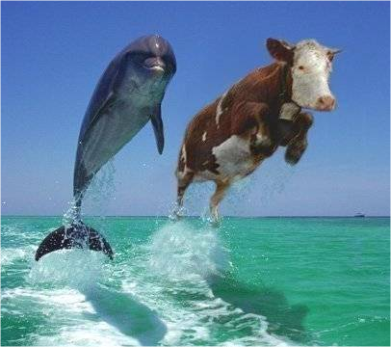
Polymorphism

Slide 12
Polymorphism
Polymorphism is the ability to take on many forms
A child class may override (change) some of the parent's methods
The beauty of polymorphism is that the code working with the different classes does not need to know which class it is using since they are all used the same way
In the programming world, polymorphism is used to make applications more modular and extensible

Slide 13
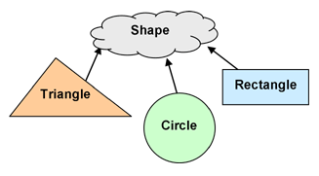
Abstract Classes

Slide 14
Abstract Classes
An abstract class is a mix between an interface and a class
It can define functionality as well as interface (in the form of abstract methods)
Classes extending an abstract class must implement all of the abstract methods defined in the abstract class.
abstract class MyAbstract {
// methods
}
Notes:
But they can be subclassed.

Slide 15
Extending Abstract Class
Abstract classes cannot be instantiated
Extending an abstract class is the same as with regular one
abstract class MyAbstract {
// methods
}
$abstract = new MyAbstract();
// Uncaught Error: Cannot instantiate abstract class
class MyClass extends MyAbstract {
// methods
}

Slide 16
Methods in Abstract Class
Regular methods can be defined in an abstract class
Abstract methods, using the abstract keyword
abstract class MyAbstract {
public $name;
public function doThis() {
// do this
}
abstract public function doThat();
abstract public function setName($name);
}

Slide 17

Concrete Example

Slide 18








OOP Fundamentals
https://softuni.bg/courses/php-basics/

Slide 19
License
This course (slides, examples, demos, videos, homework, etc.) is licensed under the "Creative Commons Attribution-NonCommercial-ShareAlike 4.0 International" license
Attribution: this work may contain portions from
"PHP Manual" by The PHP Group under CC-BY license
"PHP and MySQL Web Development" course by Telerik Academy under CC-BY-NC-SA license

Slide 20





Free Trainings @ Software University
Software University Foundation – softuni.org
Software University – High-Quality Education, Profession and Job for Software Developers
softuni.bg
Software University @ Facebook
facebook.com/SoftwareUniversity
Software University @ YouTube
youtube.com/SoftwareUniversity
Software University Forums – forum.softuni.bg

